Slide 1


Web Programming 2x1
Introduction to JavaScript

Slide 2
Web Programming 281
IMPORTANT INFORMATION
10
DURATION
ASSESSMENTS
40
3
CT1
ST
1
project
Assessment Weights
3
20
tests
CT2
weeks
1
exam
30
Project
100
Total

Slide 3
Outcomes
Students should understand the following outcomes, upon successful completion of this module:
Intro to Amateur JavaScript
What is JavaScript
What JavaScript is not (Java vs. JavaScript)
JavaScript and ECMAScript
Tour of language features

Slide 4
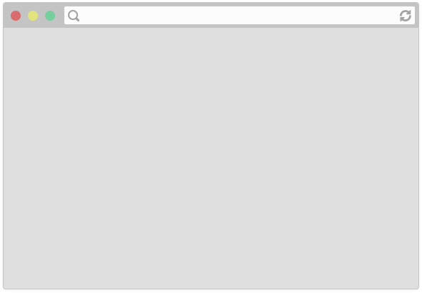

How do web pages work
http://belgiumcampus.ac.za
What happens in the background – step by step?
A user types in a URL in the address bar and hit "enter“.
Notes:
A user types in a URL in the address bar and hit "enter“.

Slide 5

How do web pages work
Browser sends an HTTP request saying "Please GET me the index.html file, located at: http://belgiumcampus.ac.za"
(Routing, etc…)
Server at: http://belgiumcampus.ac.za
HTTP requests work as the intermediary transportation method between a client/application and a server.
The client submits an HTTP request to the server, and after internalizing the message, the server sends back a response.
The response also contains status information about the request. e.g.: 404 for error or 200 for success

Slide 6
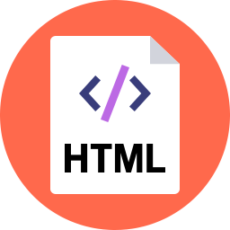
How do web pages work
Server at:
http://belgiumcampus.ac.za
(Routing, etc…)
Assuming all goes well, the server responds by sending the HTML file (resource) through the internet back to the browser to display.
Remember, the HTML file is read by the browser from top to bottom.
In the <head> tag, we will have a <link src = "style.css" .../>, which contains our styling of the HTML page.
So, before the browser loads the entire HTML file, the styles.css file is fetched by the browser, from the server
Notes:
Remember, the HTML file is read by the browser from top to bottom.
In the <head> tag, we will have a <link src = "style.css" .../>, which contains our styling of the HTML page.
So, before the browser loads the entire HTML file, the styles.css file is fetched by the browser, from the server.

Slide 7

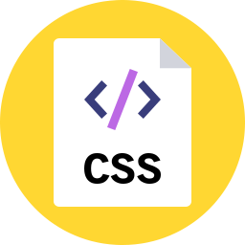
How do web pages work
Server at:
http://belgiumcampus.ac.za
Browser fetches <link src = "style.css" .../>, generating another GET request for the resource
(Routing, etc…)
And the server replies with those resources for the browser to render

Slide 8
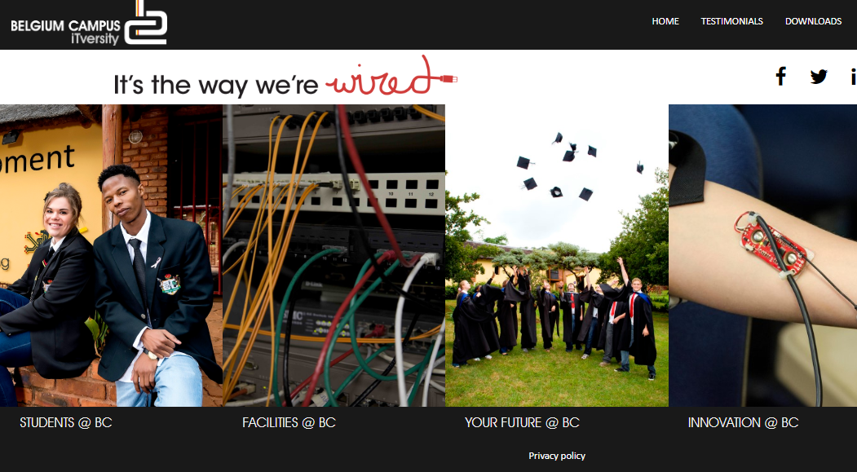
How do web pages work
Finally, when all resources are loaded, we see the loaded web page:

Slide 9
HTTP Requests
Use the following link for HTTP requests:
https://rapidapi.com/blog/api-glossary/http-request-methods/#:~:text=HTTP%20requests%20work%20as%20the,status%20information%20about%20the%20request.

Slide 10
How do web pages work
Describes the content and structure of the page
Describes the appearance and style of the page
A web page…
that doesn't do anything
This works well for Static webpages - are the most basic type of website and contains web pages with fixed content.
Each page is coded in HTML and displays the same information to every user.
We need to have Dynamic Web pages
Notes:
This works well for static web pages.
These are the most basic type of website and contains web pages with fixed content.
Each page is coded in HTML and displays the same information to every user.
We need to have Dynamic Web pages

Slide 11

Class Exercise
Group Discussion: Dynamic vs Static Websites
Notes:
Let the students choose their groups for the project, then let them research on the exercise

Slide 12

Why JavaScript ??
HTML - Adds structure to our web pages-layout, sections, and paragraphs
CSS - Adds style to our web pages/Controls the presentation and design of web pages.
JavaScript - Adds behaviour and interactivity

Slide 13

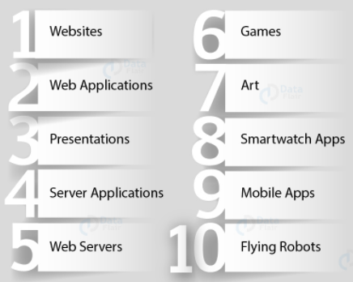
JavaScript
Applications of JavaScript
JavaScript is a text-based programming language used both on the client-side and server-side that allows you to make web pages interactive.
Where HTML and CSS are languages that give structure and style to web pages, JavaScript gives web pages interactive elements that engage a user.
https://data-flair.training/blogs/javascript-uses/

Slide 14



JavaScript Components
Core JavaScript
As a programming language apart from its intended use in web pages. Supported on both the client and server side
Client-side JavaScript
Has several additional objects, properties and methods that are supported by browsers.
Server-side JavaScript
Has additional features supported by server-side products.
Notes:
Core JavaScript is the base part of the JavaScript language that is supported on both the client and server side.
Client-side JavaScript (CSJS) contains the core JavaScript elements and has several additional objects, properties and methods that are supported by browsers.
Server-side JavaScript (SSJS) also contains the core JavaScript elements and it has additional features supported by server-side products.

Slide 15
History
The official name for JavaScript is ECMAScript
Brendan Eich developed JavaScript in 1995, while working for Netscape Communications
Was introduced as a way to add programs to web pages in the Netscape Navigator browser.
Has made modern web applications possible—applications with which you can interact directly without doing a page reload (from server) for every action.
JavaScript is also used in more traditional websites to provide various forms of interactivity and cleverness.

Slide 16
Why do we need JavaScript?
JavaScript allows the validation of forms without the input of the server, reducing traffic.
It provides wonderful tools for a more interactive and user-friendly website.
Fixes layout issues to avoid the overlapping of elements on the page.
Adds animation to the page to make it more attractive.
Only programming language that your browser can execute natively

Slide 17
Features of JavaScript
Supports OOP concepts.
It is platform-independent and case-sensitive.
Provides various in-built functions like alert(), prompt() etc.
Capable of exception handling.
It is a lightweight, interpreted programming language
Allows the use of functions with or without any name.
A function without a name is an anonymous function.

Slide 18
Pros and Cons of JavaScript
Pros | Cons
Faster Speed | Different Browser Interpretations
Reduces Server Load | Security Issues
Regular Updates | Single Inheritance
Popularity | Sluggish Bitwise Operation
Rich Interfaces
Development
Notes:
Pros:
It provides high speed to client-side languages. The various features added to the JavaScript for interactivity helps in boosting the speed.
We avoid server traffic by validating user input on the client-side. It reduces server load, giving it an advantage over other web languages.
The team updates JavaScript annually that provides an edge to JavaScript. This also makes JavaScript a lot more reliable.
We use JavaScript almost everywhere on the web
JavaScript provides numerous interfaces to make the webpage more interactive.
JavaScript saves the compilation time, this results in faster development of applications.
Ease of Learning
Cons:
All browsers don’t interpret JavaScript in the same manner. Different browsers often display content differently.
Since JavaScript is a client-side language, people may exploit it for malicious practices. Due to this reason, some users prefer to disable JavaScript on their device.
It only supports single inheritance and not multiple inheritance.
JavaScript uses 32-bit bitwise operands but 64-bit floating-point numbers. Thus before performing any operation, JavaScript converts the number to 32-bits signed integers. After the operation, it converts them back to 64-bits JavaScript numbers. This reduces the speed taken by the script.

Slide 19

Install Microsoft Visual Studio Code
https://code.visualstudio.com/download
Notes:
Use link to download latest version of VS Code, and install on your PC

Slide 20
Thank You!
The End
/belgiumcampusSA
#Belgium Campus
info@belgiumcampus.ac.za
+27 10 593 53 68
/belgiumcampus

